Slide 1


Slide 2

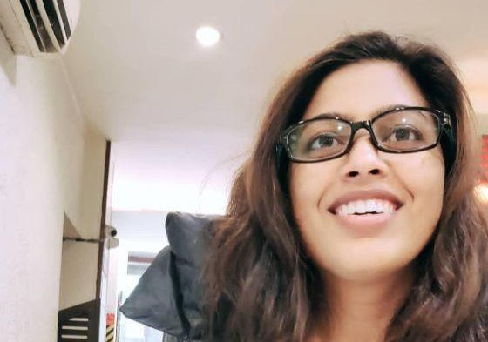
I believe in insight driven integrated communication with a focus on helping businesses and institutions transform the way you do business, go to market and communicate with the people that matter most.
A Post Graduate Diploma in Advertising & Public Relations from Indian Institute of Mass Communication, New Delhi
With 9 years of experience in communication management
Currently working as LEAD- COMMUNICATION & PUBLIC RELATIONS at TRIDENT LIMITED, a 1+ USD Billion Dollar conglomerate with customer footprint over 150+ countries in the world.
Managing B2B & B2C communication for Copier Paper, Stationery, Bath Linen, Bed Linen, Yarn & Detergent Businesses
Have also worked on launching a D2C E-Commerce Platform
The incumbent is responsible for managing brand promotions in India, UK, Germany, Dubai and the US.
In the coming slides, you can see glimpses of a few projects under different yet connected domains of communication management for brand building, corporate communications and public relations.

Slide 3
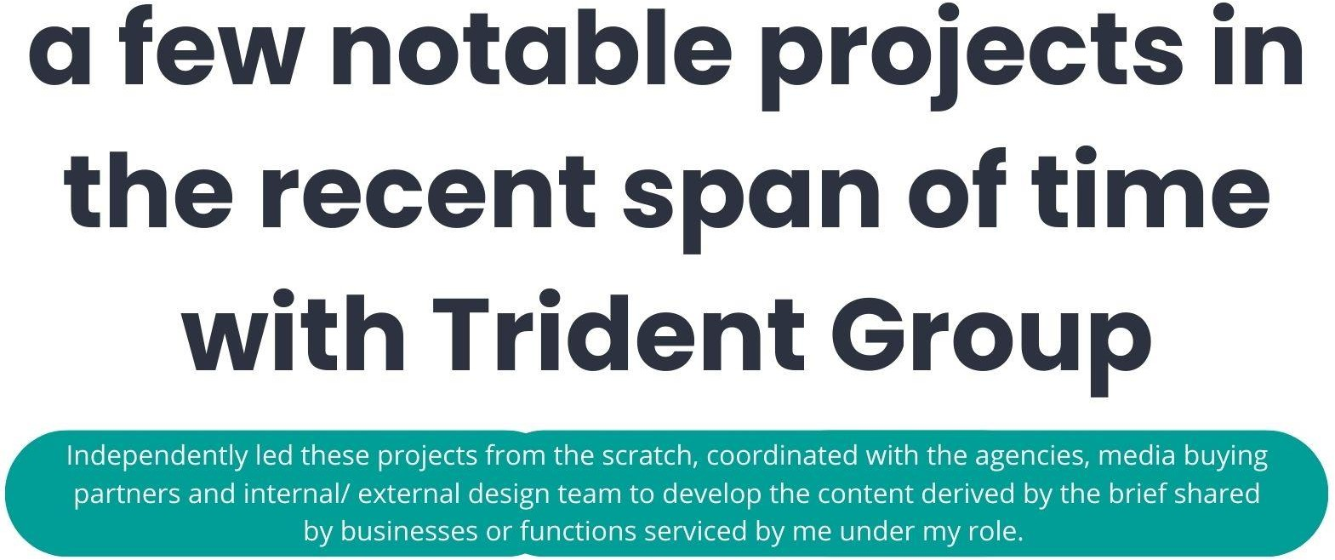

Slide 4
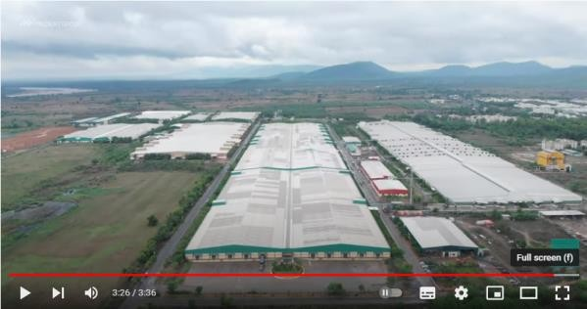
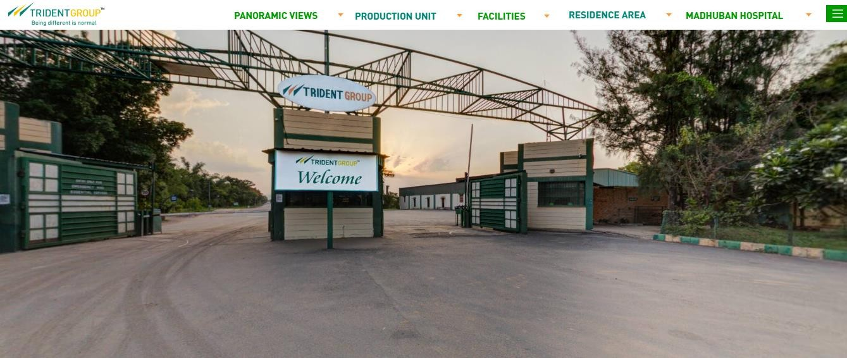
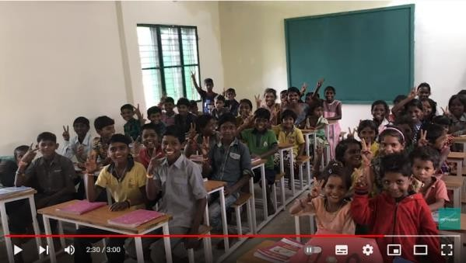
Corporate Communication Digital Asset Development & Promotion
Trident Group- Being Different is Normal Corporate Video
https://youtu.be/gwqP9ylcJMA?si=4A_LeAj5IUKIzmwR
First of its kind, an immersive experience of the factory through the 360-degree virtual tour of the Manufacturing Factory at Budhni, India, developed during COVID times to bridge the gap between us and our customers and other stakeholders.
TRIDENT FACTORY TOUR (tridentindia.com)
Trident Group – CSR Video
https://youtu.be/243oaRpm4xY?si=Db_JMicg6EtUdvF-

Slide 5
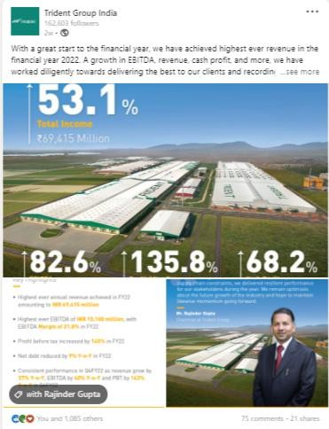
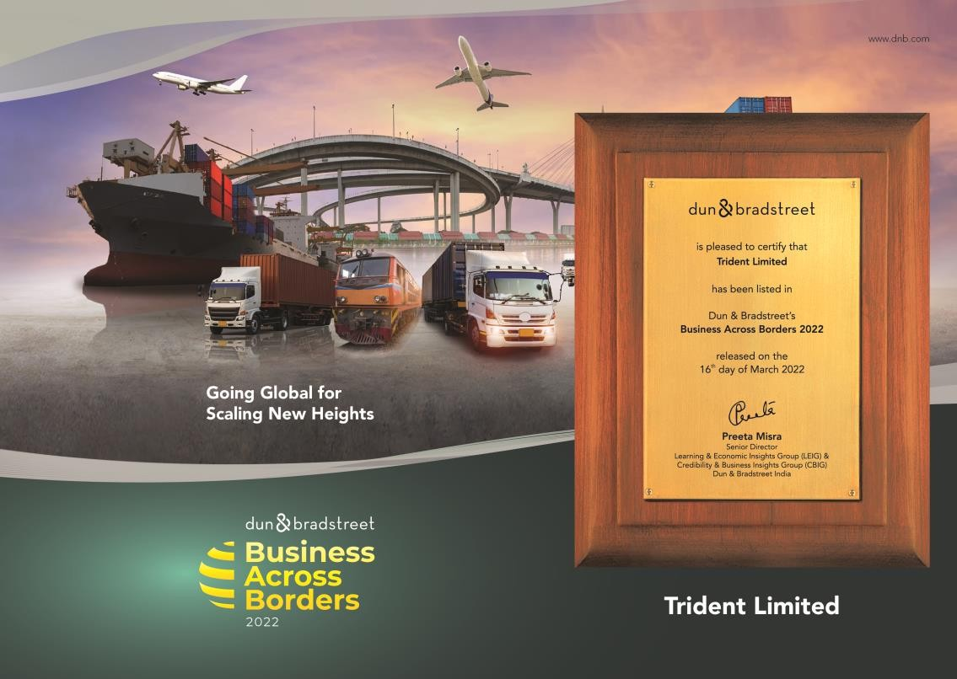
Brand Messaging & Alliances for Financial PR
Worked on messaging development, placement of the communication around the set communication pillars.

Slide 6
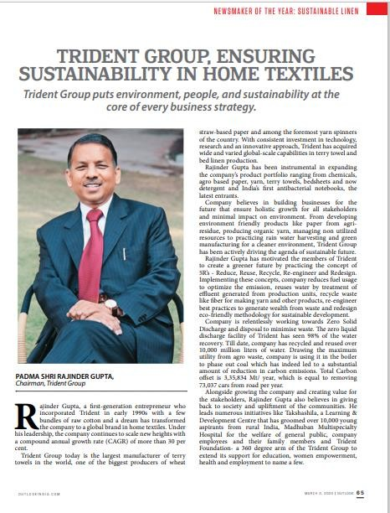
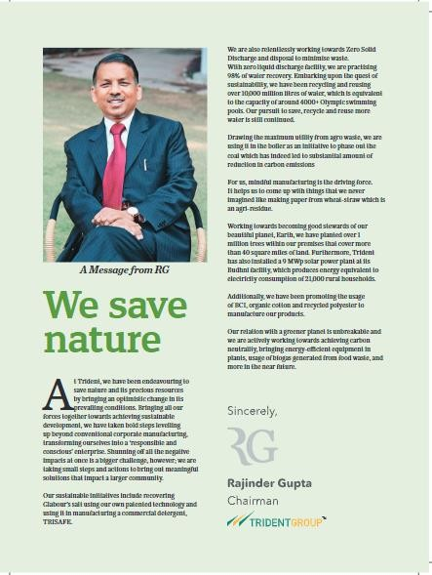
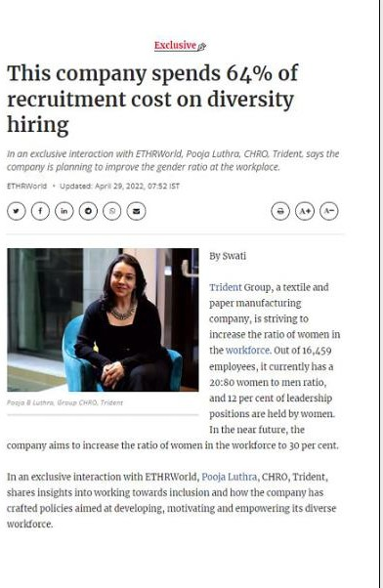
Coverage in Trade and Business Publication for Sustainable Manufacturing Practices - 1
Worked on messaging development, placement of the communication around the set communication pillars.

Slide 7

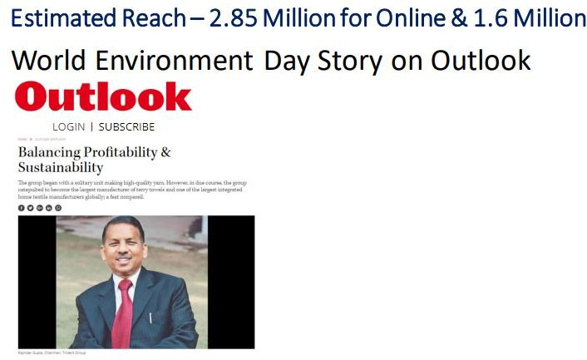
Coverage in Trade and Business Publication for Sustainable Manufacturing Practices - 2
Balancing Profitability & Sustainability (outlookindia.com)
Worked on messaging development, placement of the communication around the set communication pillars.

Slide 8
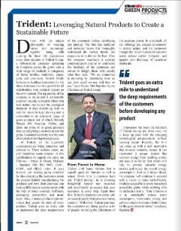
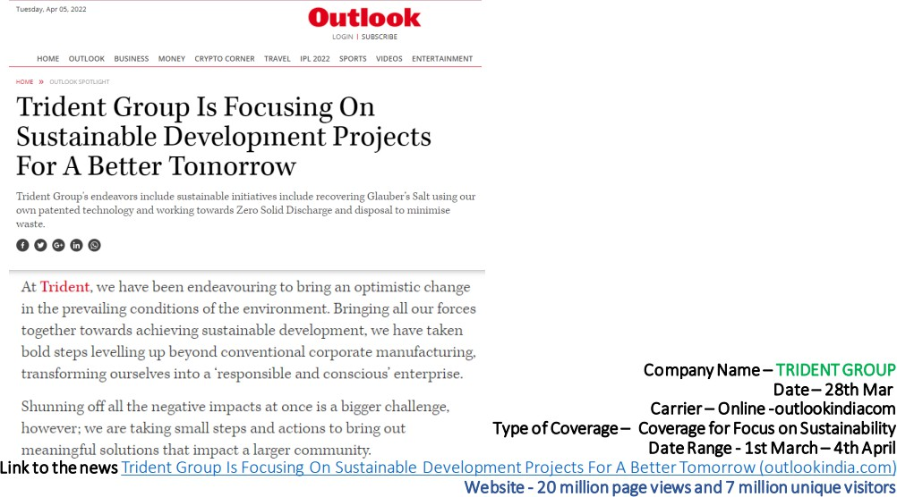
Coverage in Trade and Business Publication for Sustainable Manufacturing Practices - 3
Worked on messaging development, placement of the communication around the set communication pillars.

Slide 9
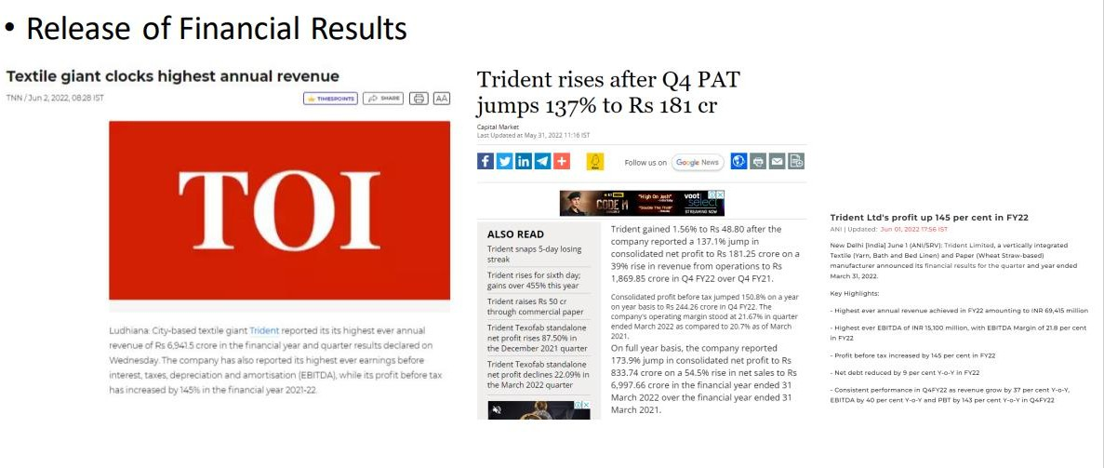
Coverage in financial publications
Worked on amplifying the announcement, messaging development, placement of the communication to reinforce the robust financial health of the company.

Slide 10
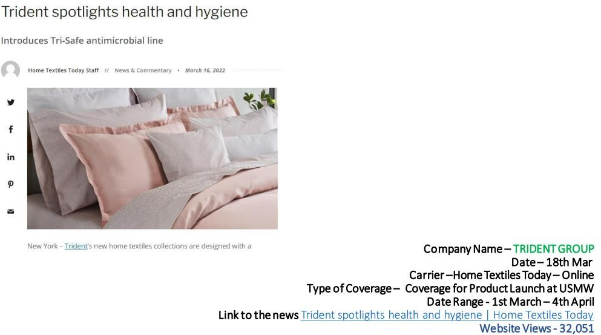
Coverage for Product Launch in The US
Worked on messaging development, placement of the communication around the set communication pillars.

Slide 11
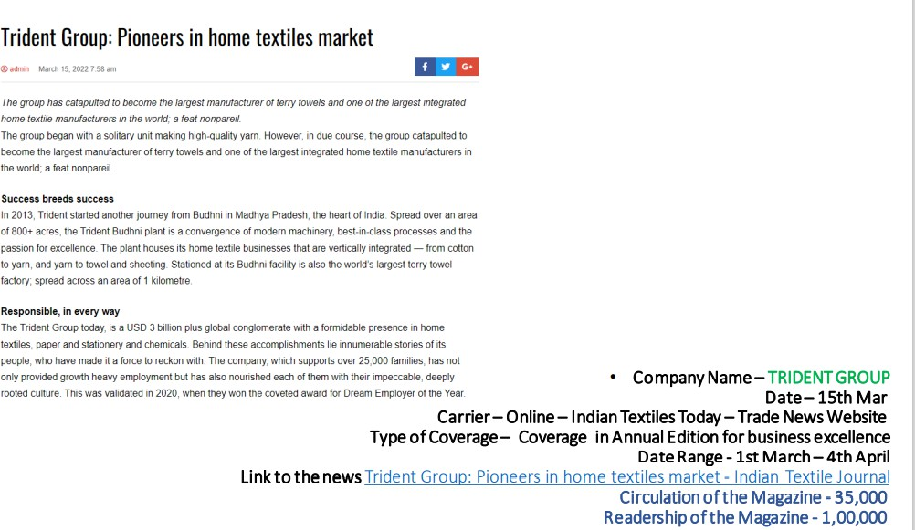
Coverage in Trade Publications
Worked on messaging development, placement of the communication around the set communication pillars.

Slide 12
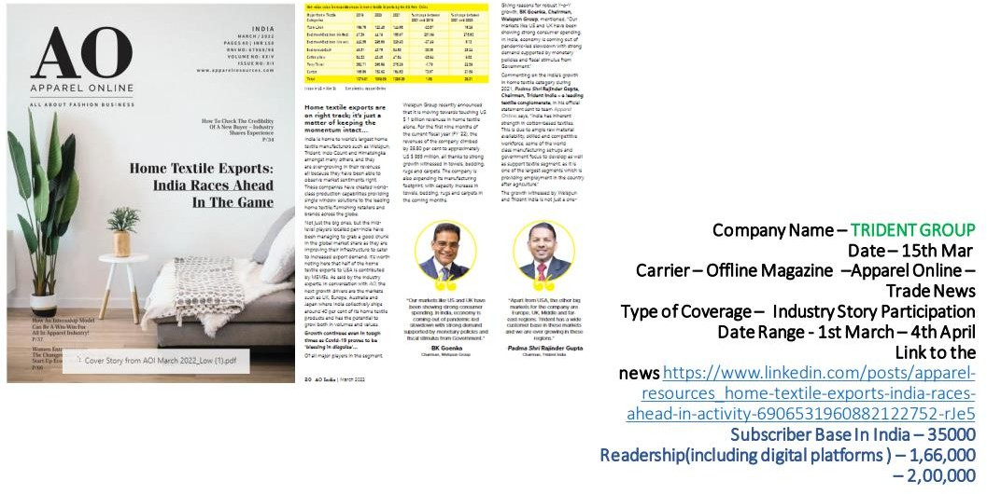
Industry Story Participation
Worked on messaging development, placement of the communication around the set communication pillars.

Slide 13
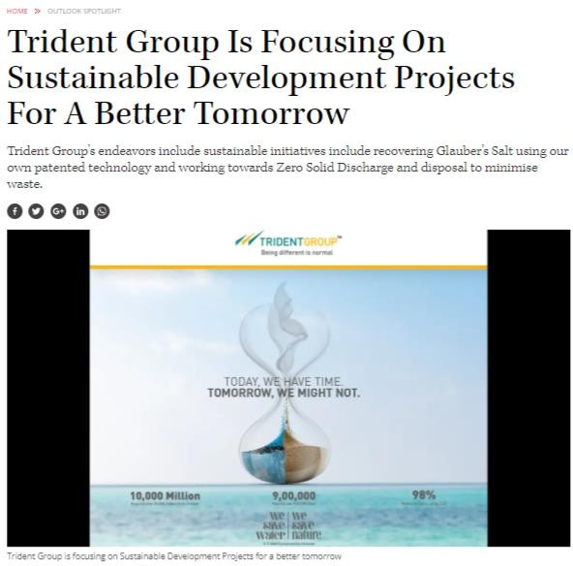

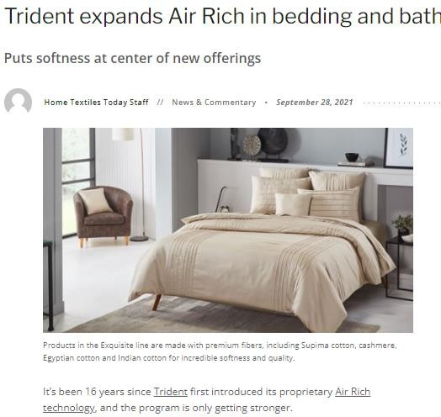
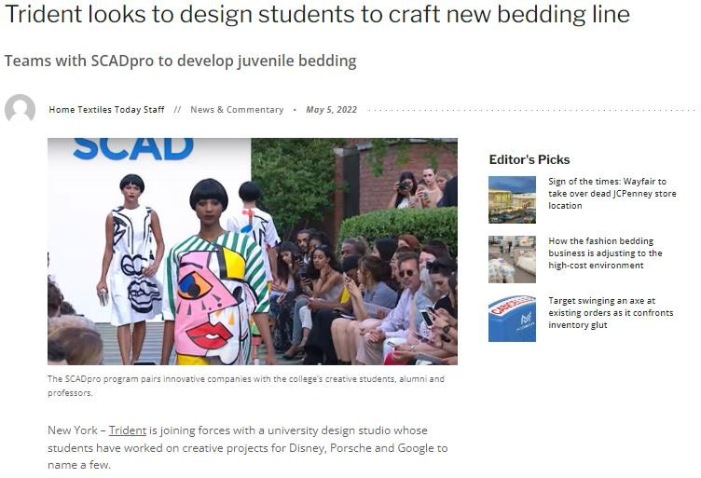
Coverage in Business and Trade Publications
Trident looks to design students to craft new bedding line | Home Textiles Today
Trident Group Is Focusing On Sustainable Development Projects For A Better Tomorrow (outlookindia.com)
Worked on messaging development, placement of the communication around the set communication pillars.

Slide 14
Leadership Profiling
Reached out to these publications, pitched the stories and garnered the coverage around the key communication pillars of business excellence, sustainability, diversity and inclusion at workplace.
Interviews and Articles in Outlook Magazine, ET HR World, etc

Slide 15
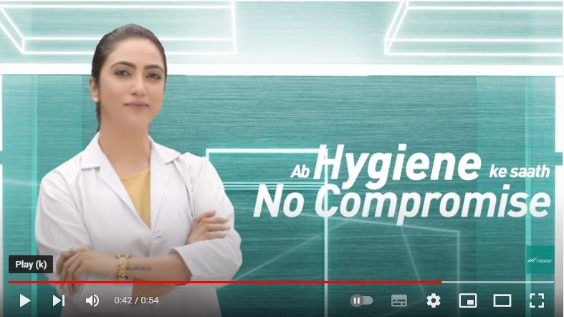
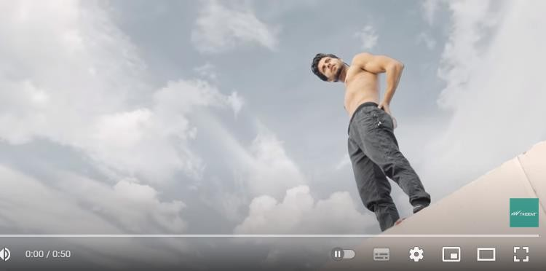
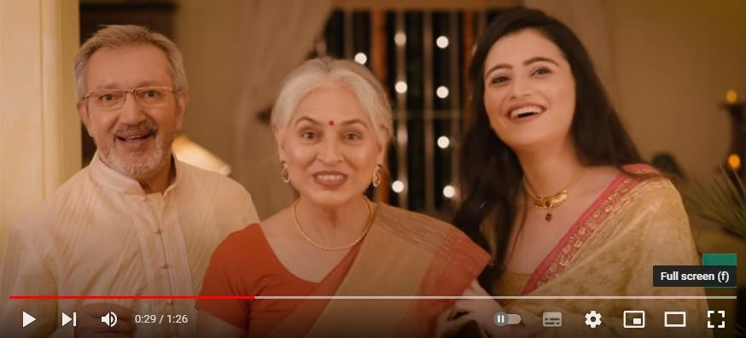
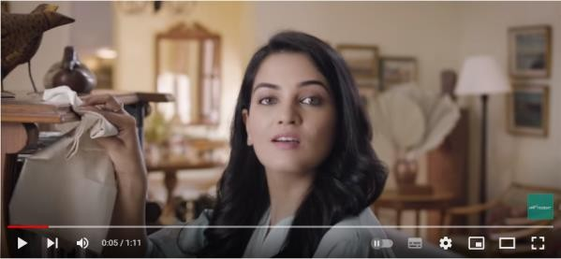
Storytelling through DVC Campaigns – covered in advertising media
https://www.exchange4media.com/marketing-news/trident-group-rolls-out-new-digital-campaign-for-threenew-offerings-109611.html
Trident Fabo Towel | Ab Hygiene Ke Saath No Compromise
https://youtu.be/OlZK80yEX3c?si=EQud-1_bRfR0PTiT
Trident Play Towel| Keep Sweating, Keep Shining!
https://youtu.be/_UQZnvPWAlU?si=E-l6Hdttz0zAXUee
Trident Diwali Collection – Trident Rishton Ka Bandhan- Tohfa to bas bahana hai
https://youtu.be/n91MUFJOYcw?si=-IYTJdvEX_7GrQtS
Trident Tri-safe Towel| Your Everyday Essentials Towel
https://youtu.be/iWkypM8u354?si=rSC9ktYfVCi8pdGh

Slide 16
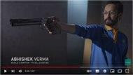

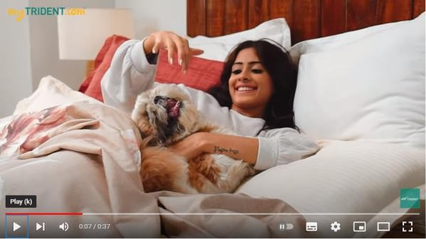
Storytelling through DVC Campaigns
Trident Signature Bed Linen| Contemporary Stylish
Trident Play Towels| Extra absorbent, fast- drying, and easy to carry
Sanskriti Collection by Trident
https://youtu.be/ZlOstoY0Zzk?si=ZjGupU4Uiek3a0yf
Worked on the concept, brief written and agency management of the production houses to make these brand films.

Slide 17

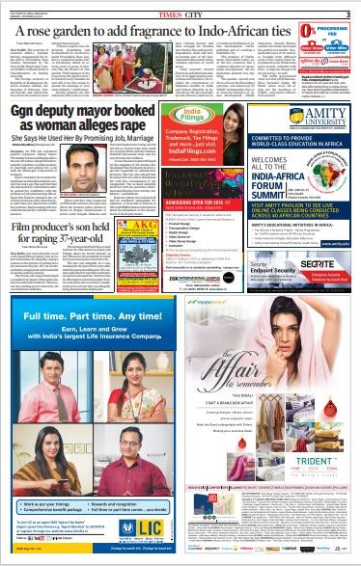
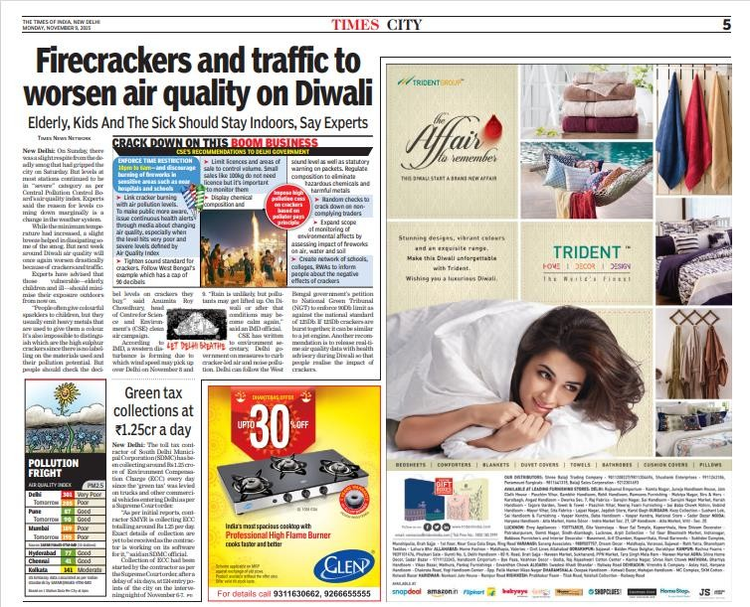
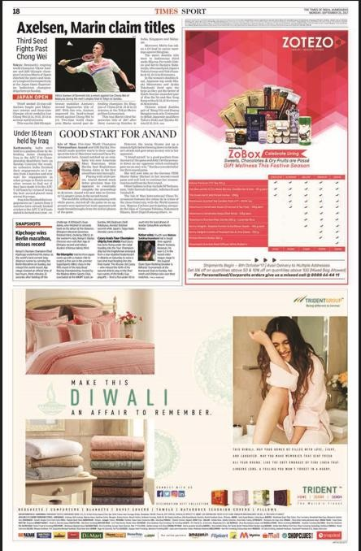
Managed Celebrity Endorsement for Home Brand – Trident Home Décor Design – Digital & Print Campaign
Launch Campaign_ PAN India Newspaper Advertising Campaign
Media Planning and Media Buying and Agency Management for Ad Creatives.

Slide 18
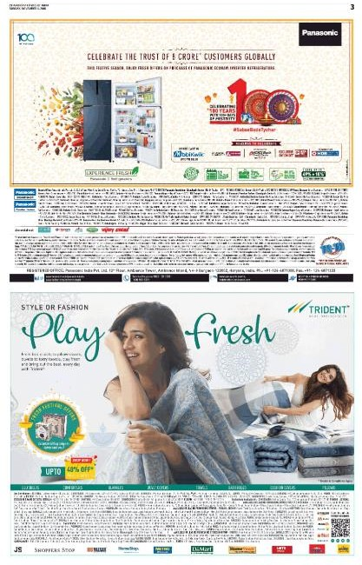

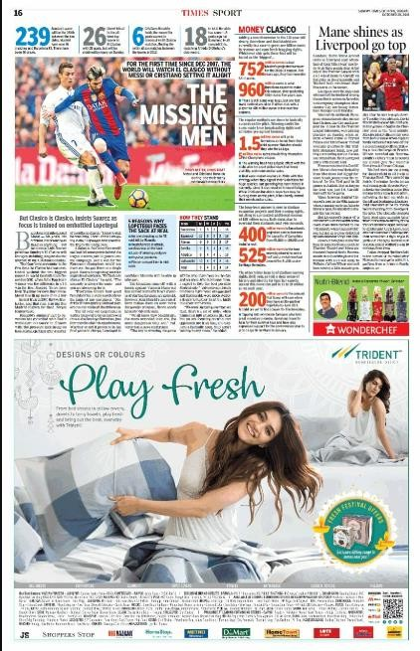
Newspaper Ads for Brand Promotion
Launch of Campaign through a National Print Advertisement Campaign with a budget spent of INR 3+ Crore
Media Planning and Media Buying and Agency Management for Ad Creatives.

Slide 19
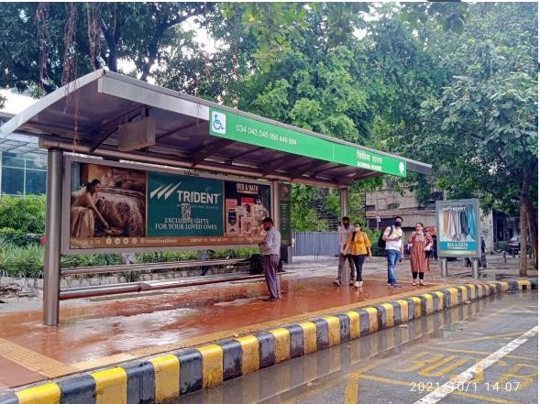
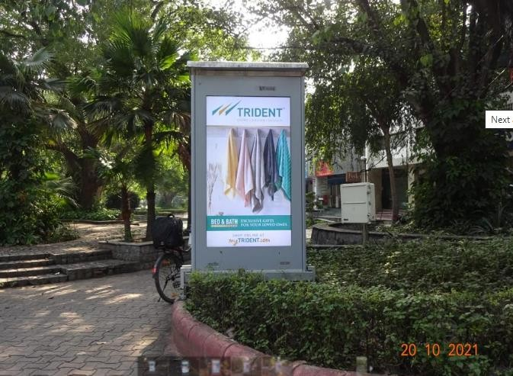
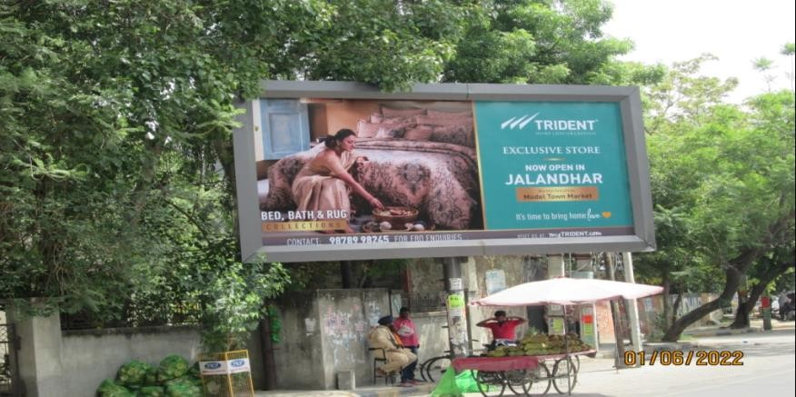
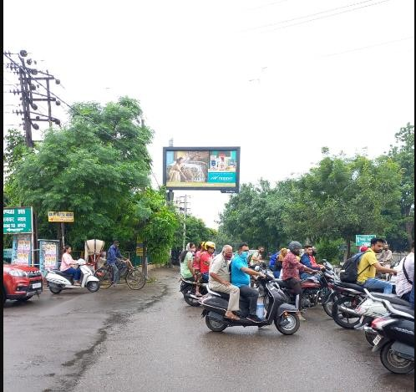
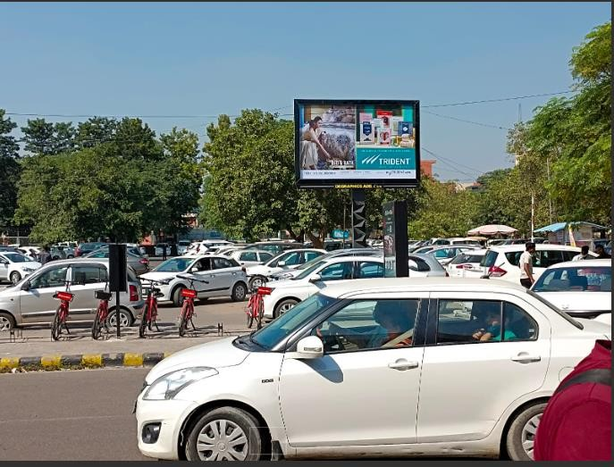
Outdoor Hoarding Campaign Management
Launch of Campaign for Gifting Collection of Bed and Bath Linen Range- PAN India with a budget spent of INR 3+ Crore
Managed the media planning & buying for these campaigns and worked closely with the content writers and the designers to develop the communication.

Slide 20
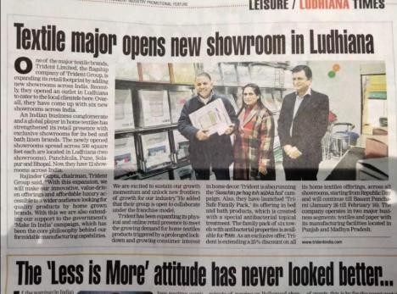
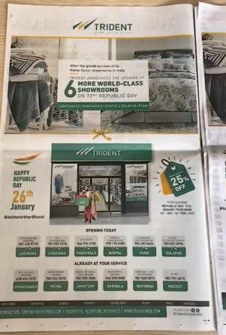
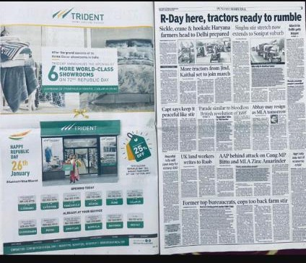
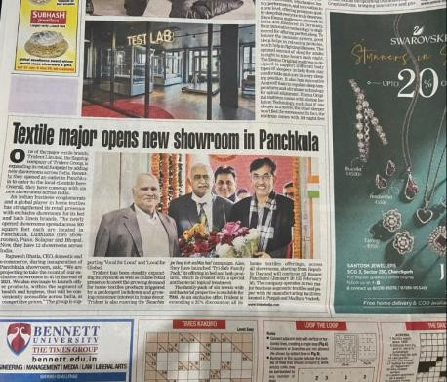
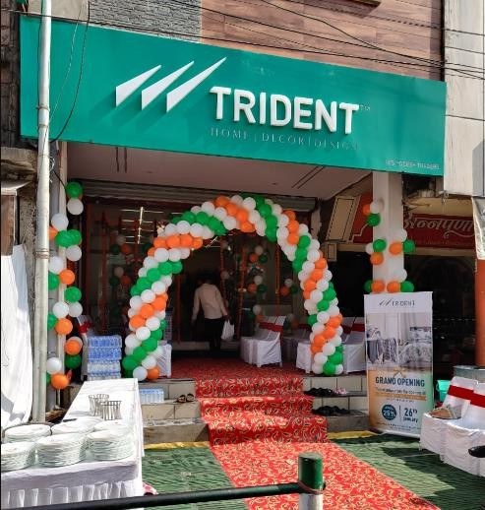
Exclusive Brand Outlet Launch Campaign
Advertising and PR
Managed the media planning & buying for these campaigns and worked closely with the content writers and the designers to develop the communication.

Slide 21
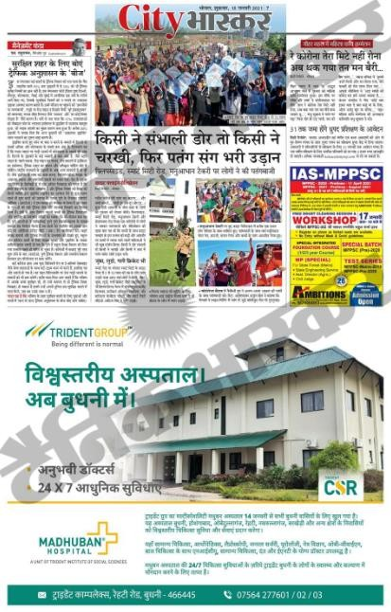
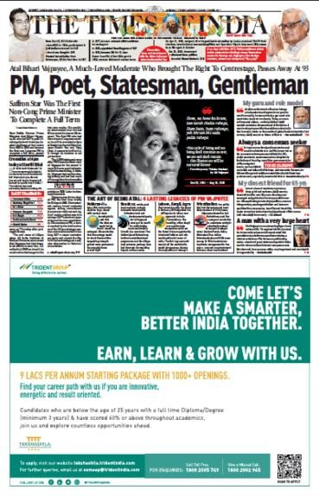
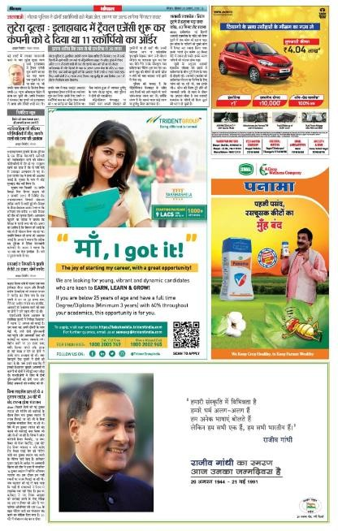
Corporate Communication – Newspaper Ads
CSR Ad & Recruitment Ad – PAN Indian Newspaper Campaign with budget spent of INR 2+ Crore
Managed the media planning & buying for these campaigns and worked closely with the content writers and the designers to develop the communication.

Slide 22
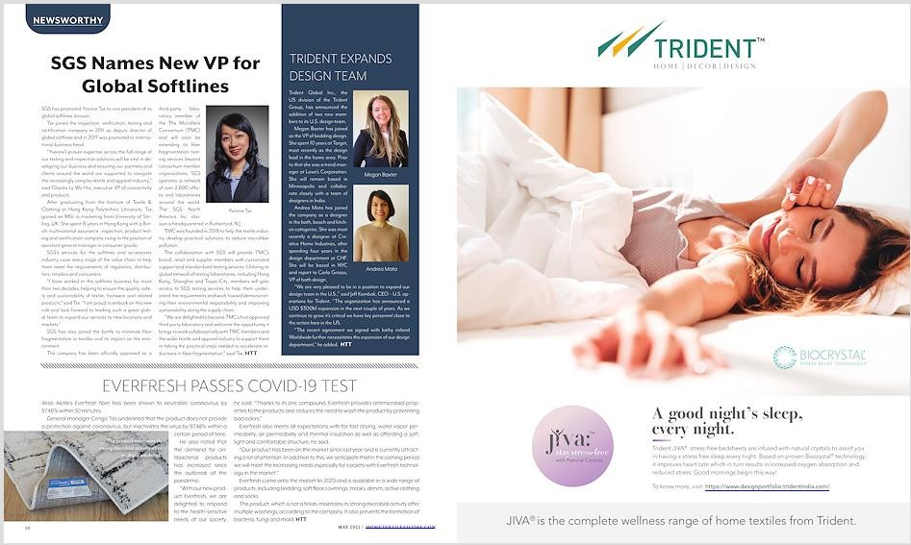
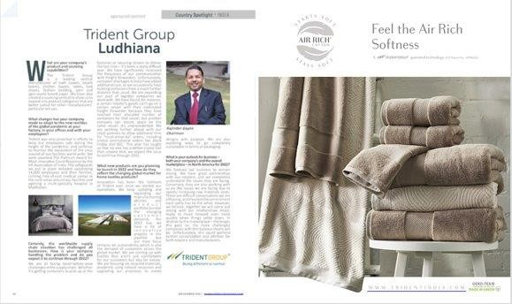
Advertising & PR in US Market

Slide 23

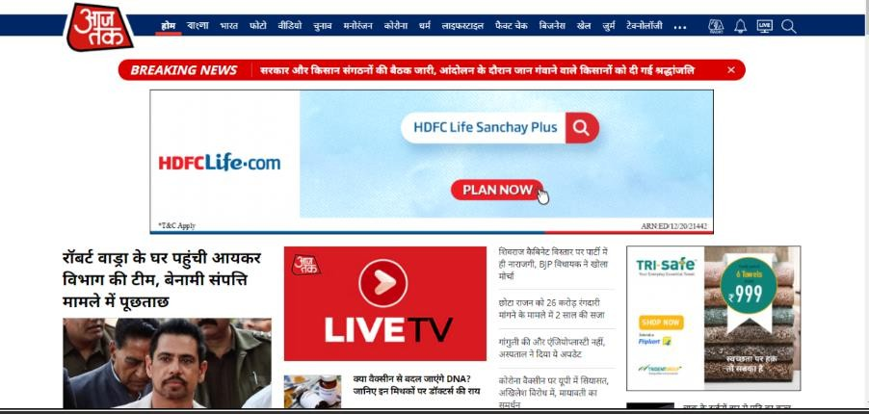

Digital Media Marketing
Management of advertising on third party websites, influencer management, video promotions, contextual advertising and content planning for social media page to build the community and manage the online reputation of the brand.

Slide 24





A few of the events managed for Trident Group
Managed venue branding, advertising and promotion for participation in these trade events and fairs for the company from brand communication point of view at all touch points. A few of such events are HGH –home décor gift houseware fair, Paper Ex, Yarn Ex, Vigyaan Mela, FICCI, CII, New York Market Week, Heimtextil, etc.

Slide 25










A few of the managed agencies and partners

Slide 26












EXPERTISE & RESPONSIBLITIES AT CURRENT JOB ROLE:
CORPORATE COMMUNICATION
PUBLIC RELATIONS
BRAND MANAGEMENT
MEDIA BUYING
EVENT & SPONSORSHIP MANAGEMENT
ATL & BTL
ACTIVITIES
ADVERTISING
MANAGEMENT
MARKETING COMMUNICATION
AGENCY MANAGEMENT
LEADERSHIP POSITIONING
CONTENT STRATEGY & MARKETING
ESG COMMUNICATION MANAGEMENT
REPUTATION MANAGEMENT
DIGITAL CAMPAIGN MANAGEMENT
ONLINE REPUTATION MANAGEMENT
CAUSE MARKETING & CSR

Slide 27
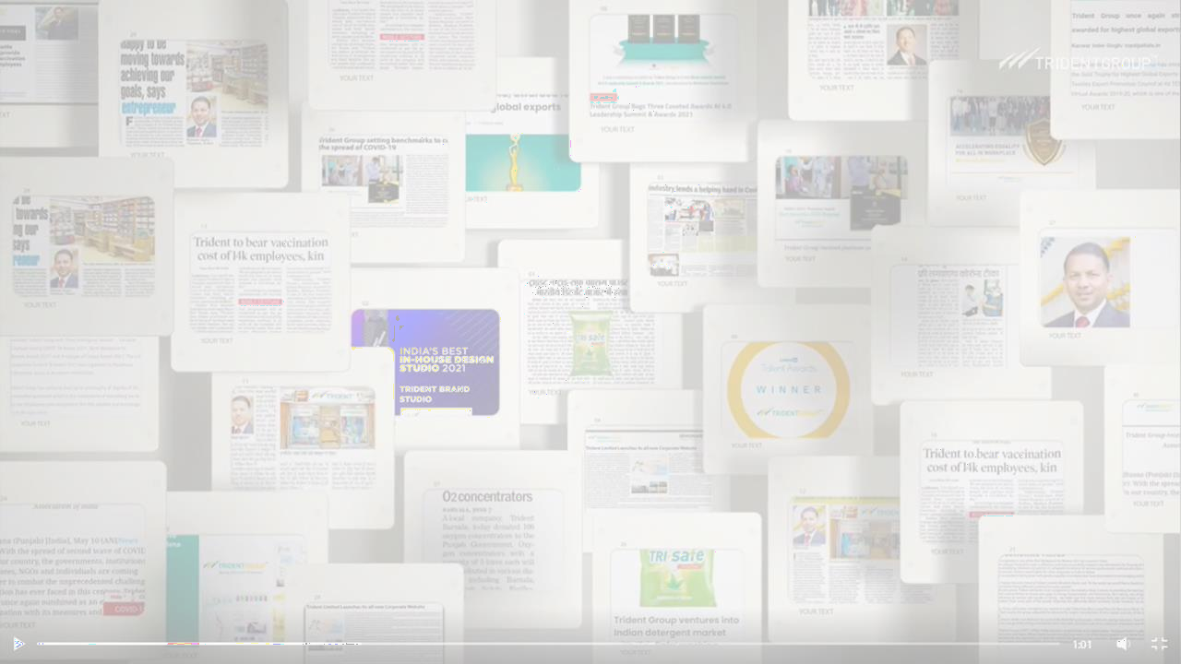
THANK YOU!
KANCHAN SONDHI
Communication Specialist
Email ID – kanchansondhi@gmail.com

